Slide 1


Slide 2


Codesign Supercomputer Fugaku and Target Applications through Performance Optimization
Kazunori Mikami, Hirofumi Tomita, Kazuo Minami
RIKEN Center for Computational Science
Notes:
Hello.
This is Mikami of RIKEN
Our poster is titled
[Codesign Supercomputer Fugaku and Target Applications through Performance Optimization]
Let me go through it.

Slide 3


Codesign
Supercomputer Fugaku
the flagship supercomputer of Japan
development began in FY2014, user service will start in FY2020
target applications
represent the social/scientific priority issues selected by the ministry
codesign
simultaneous development of Supercomputer Fugaku and the target applications using applications performance measures, under power constraint
codesign goal
complete Fugaku, make it deliver the computing capability needed for scientific achievements
modernize target applications to achieve expected performance on Fugaku, and on similar HPC systems
Notes:
codesign is the methodology of simultaneous development of Supercomputer Fugaku and target applications using performance measures.
Fugaku is the flagship supercomputer of Japan.
The target applications represent 9 social/scientific priority issues selected by the ministry.
The major goals of codesign are: (1) complete Fugaku shaped to deliver the capability for scientific demand, and (2) modernize the target applications

Slide 4
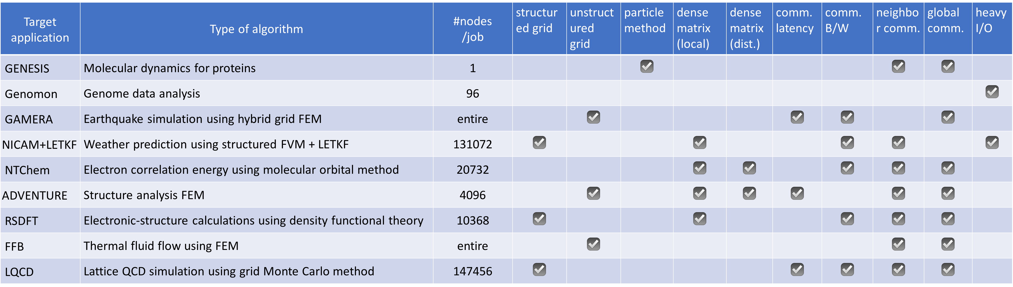
Target applications
computational characteristics
use different numerical schemes, grid structures, data types
cover typical applications workload in total
objectives
achieve satisfactory performance – each app has Fugaku speed-up v.s. K goal as the combination of codesign effort
be good reference for the succeeding applications
Notes:
The target applications cover a range of computing workloads.
Their brief description, the size of target problems, and the computing characteristics are shown in the table.

Slide 5
Codesign view
codesign from target applications view
Repeat optimizing the application, interacting with system development
identify the performance bottleneck utilizing performance tools
optimization effort in applications
alternative algorithm, source level manual tuning
system design improvement request for feasibility study
rerun the cycle with new source code and new design parameters
look for further optimization possibility from different angles
difference from K-computer in mind
Architecture: Arm base 512 bit SVE, many cores per CPU, smaller # of registers and increased OoO resource, memory/CPU increased, memory/core decreased
Open source community: lots of S/W available around
Notes:
From target applications view, codesign is [Repeated optimization of the application, interacting with system development]
They first identify the performance bottlenecks using tools, and try optimizing themselves.
They raise the request of system design enhancement, if appropriate.
And rerun the cycle looking for further optimization
[Skip]
Fugaku is quite difference from its predecessor K-computer.

Slide 6
Application performance analysis using tools
performance analysis tools are used per availability at phases
tools for analysis on existing platform
general profilers(fipp/fapp) statistics
precise PA (HWPC) for detail component analysis
flops, intops, B/W, SIMD rate, cash hit/miss, ..
tools for Fugaku performance prediction
PA prediction tool using FX100 precise PA : static, interpolation, quick
instruction simulators : dynamic, accurate, expensive
hardware emulator
Fugaku prototype test vehicle
prediction tools are private ,except for RIKEN simulator available at https://github.com/RIKEN-RCCS/riken_simulator
Notes:
Multiple performance tools are used at phases
Tools for existing platforms include general profilers, and precise PA tools (which uses HWPC).
Tools for Fugaku prediction include PA prediction tool, instruction simulators and others.
[Skip.]
PA prediction tool gives simply scaled numbers which tends to give upper bound for a given code,
and instruction simulators accurately reflect cycle level processing

Slide 7
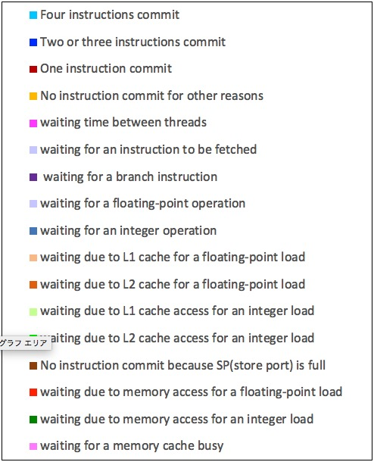
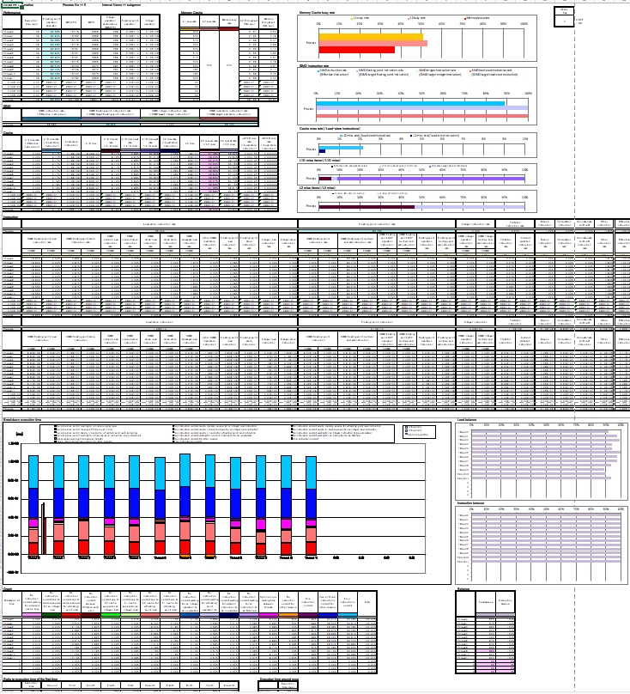
performance optimization typical practice
bottleneck analysis using tools
conduct precise PA component analysis on FX100
try many tuning patterns with Fugaku specification in mind
evaluate the tuning effect on Fugaku using prediction tools
the results can be significantly different between tools, all of them should be reviewed in comparison
precise PA snapshot
addressing bottlenecks
discuss how the bottleneck should be improved
applications: tuning effort in applications is essential
system S/W: enhancing compilers and libraries
system H/W: specification design and implementation enhancement
Notes:
Application developers analyze and identify bottlenecks using these tools.
Now, addressing the bottleneck is the main body of codesign.
People get together and discuss how the bottleneck should be improved from each view of application, system S/W and H/W

Slide 8
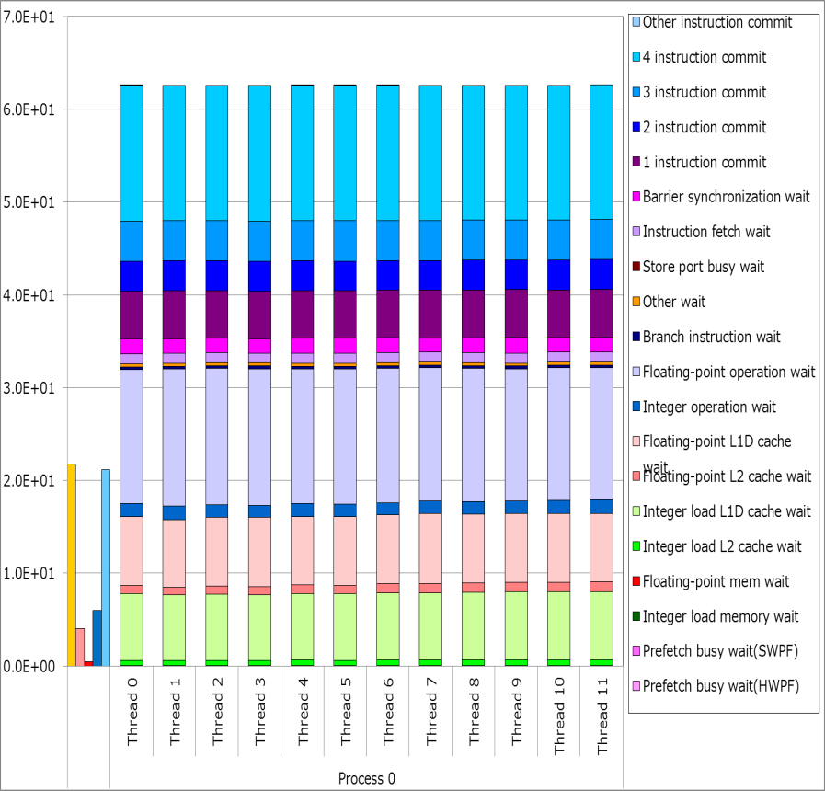
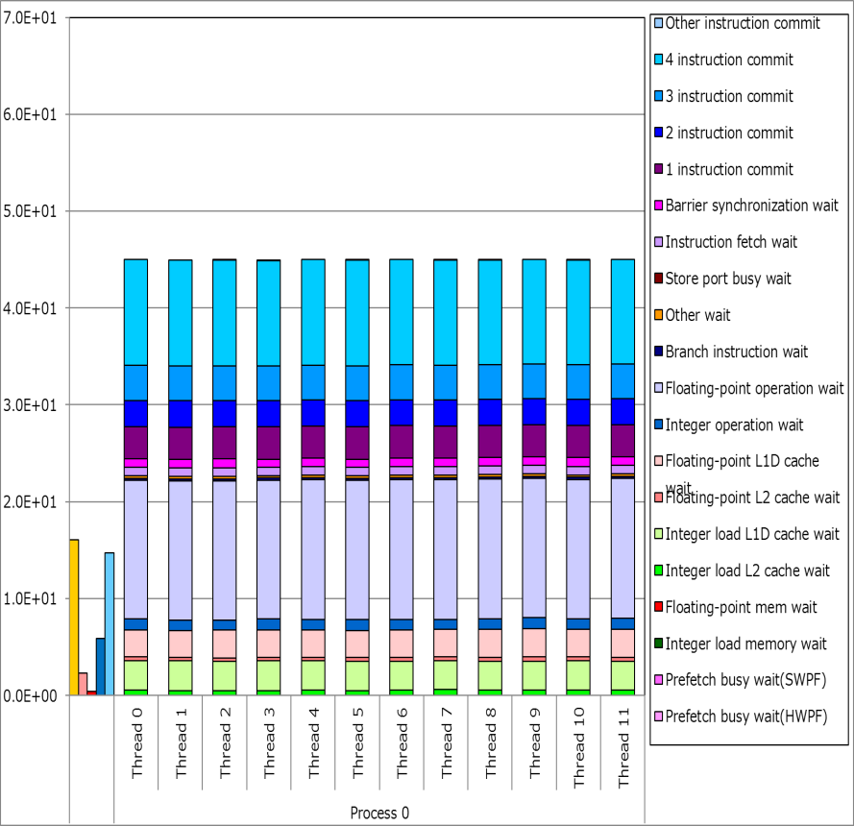
performance optimization
optimization in applications
manual tuning is required in many situations
choose good algorithm, most importantly
simplify the code structure, rewrite code for better instruction mix
many of known tuning tactics for servers are usually effective
give compilers helping information via directives and options
time in vertical axis
Color represents the architectural components where the instructions are handled and are busy.
Scalar code example
Loop fusing for longer loop
Dimension exchange for shorter memory access stride
The effect
reduced data access wait time (lower green and flesh color)
still long f.p. ops wait time (violet) because of sequential(non-SVE) ops
Notes:
I pick up applications effort first, because it is quite important above all.
Manual tuning is conducted on all applications.
Tuning tactics on major servers are usually effective on Fugaku as well.
The bar graph in left shows wall time of a scalar kernel. A quick tuning explained in right box resulted in wait time reduction, still wanting vectorization, though.

Slide 9
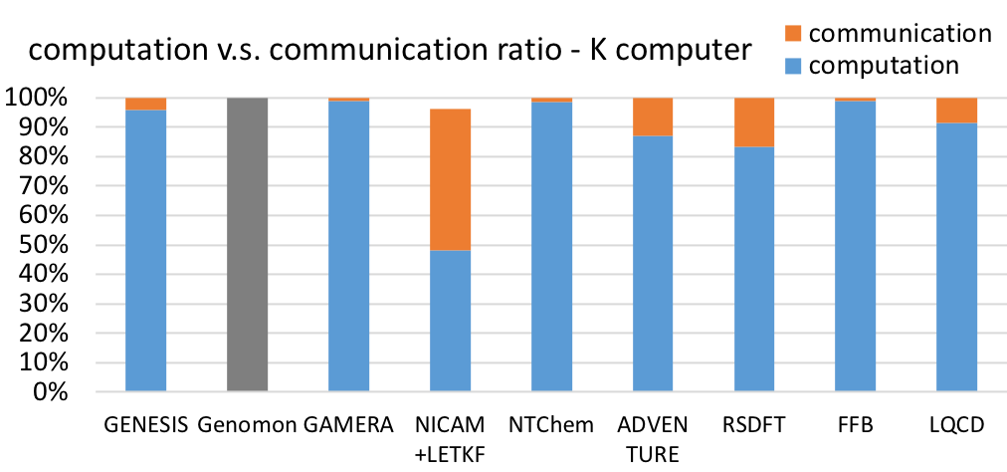
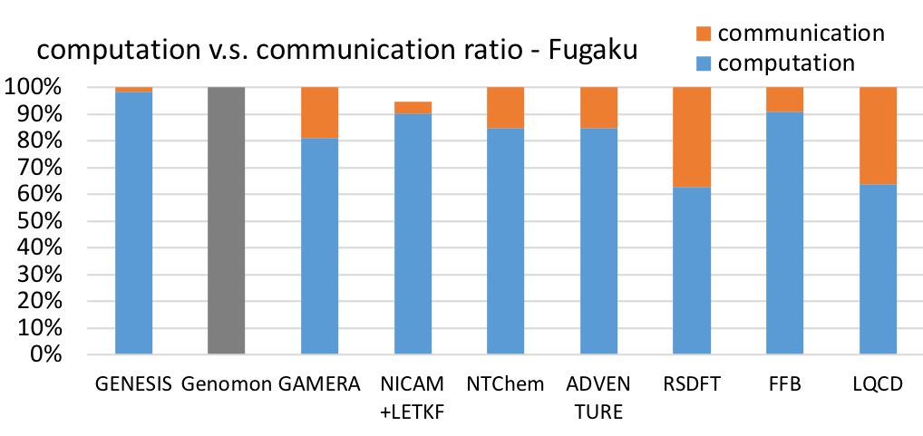
performance optimization
Fugaku Tofu-D enhancement
assistant cores : support resource for non-blocking communication
small size global data reduction within Tofu-D : offloading work from CPU
optimization effort in communication bound app
node injection B/W relative to peak f.p. rate is not so high as K, so the communication bound applications need attention
NICAM+LETKF deployed new frame work adopting global MPI_alltoall among all members, instead of sequential MPI_gather/scatter from every ensemble member, which resulted in dramatic performance improvement
Notes:
This example shows the aggressive effort in NICAM+LETFK application.
to address MPI communication bound workload, the application deployed a new framework
utilizing MPI all2all instead of MPI_gather/scatter and achieved dramatic performance improvement.

Slide 10
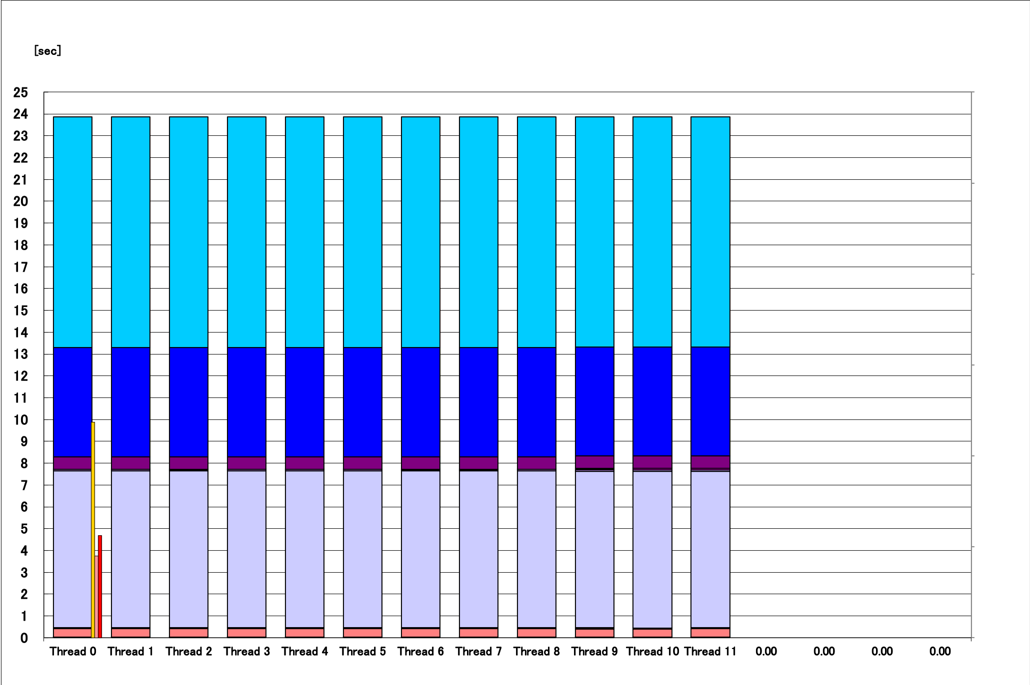
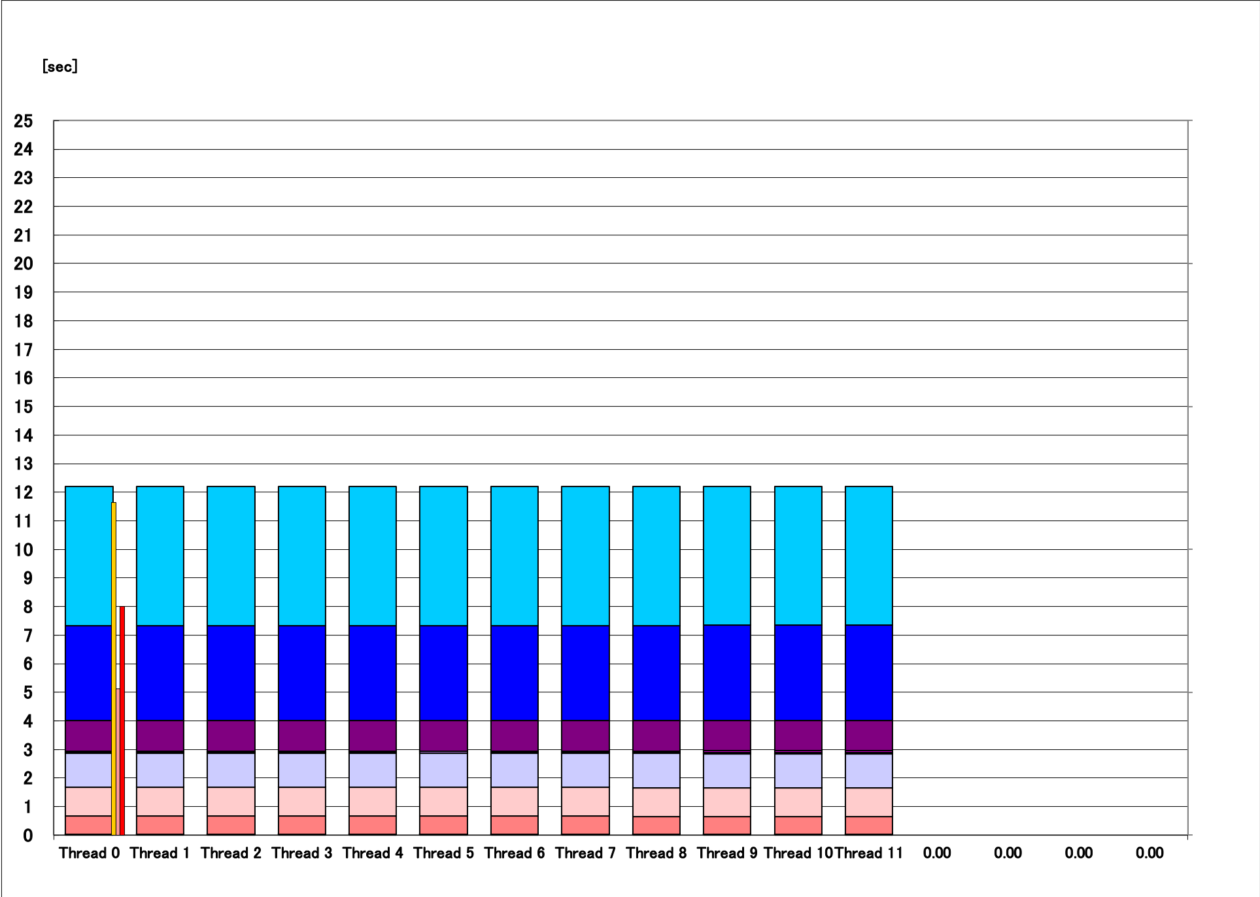
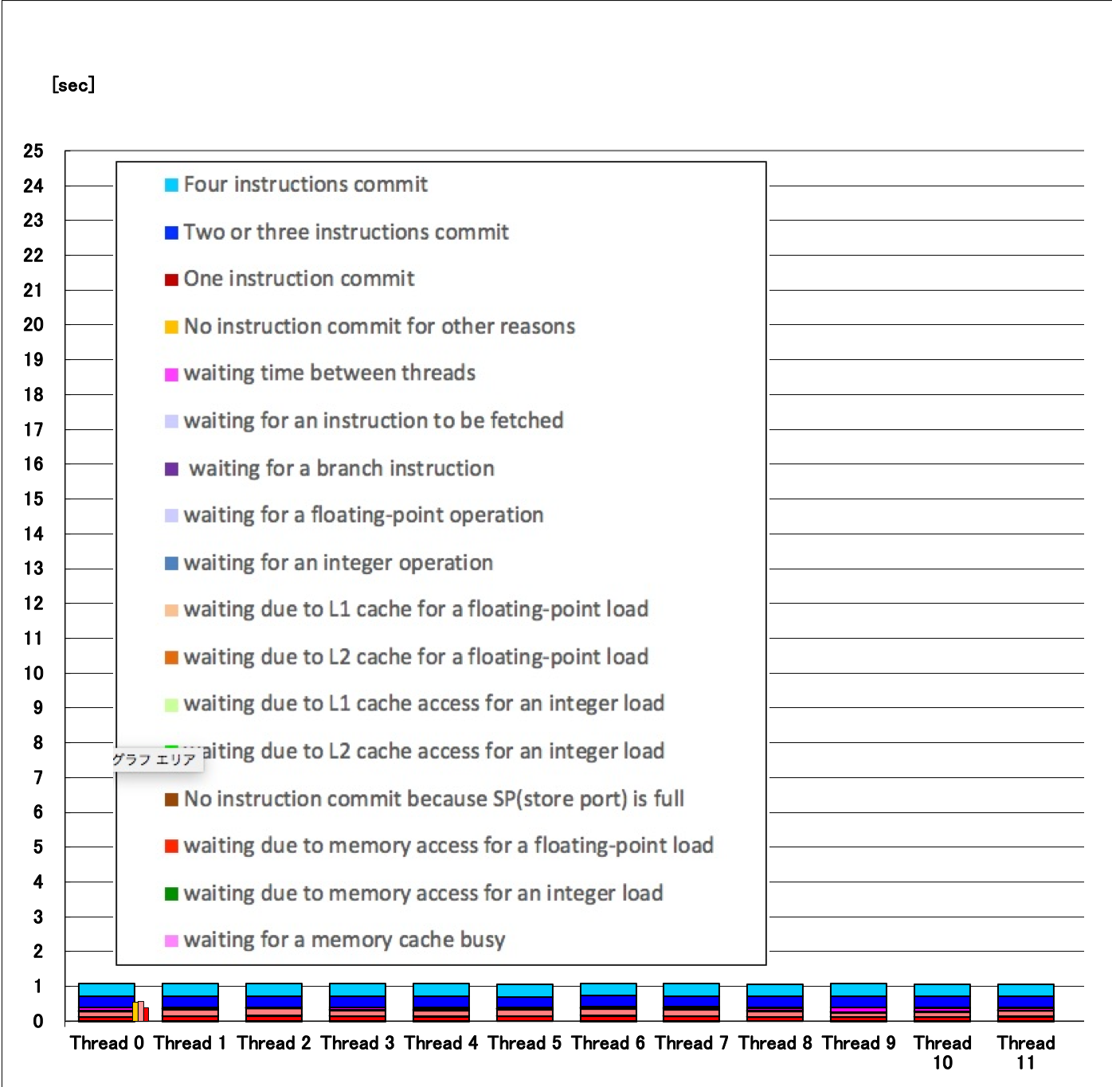
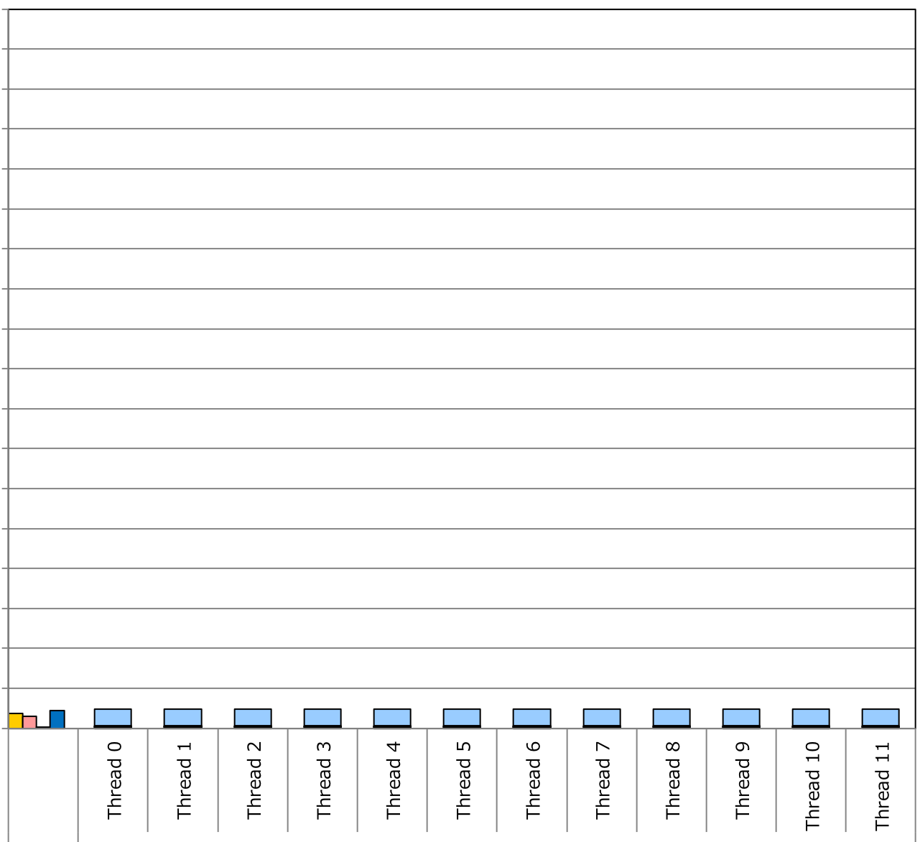
performance optimization
optimization in system software
incorporate the learnings from manual tuning into compilers
automatic optimization feature
additional fine control directives
useful compiler messages for performance consideration
Advantage of applying SVE, aka wide SIMD, is evident, but other optimization is also important
compiler’s automatic optimization feature
seq. and serial inner prod.
unrolling
aggressive optimization
Fugaku
compiler aggressive optimization
loops restructured,
SVE SIMD instructions,
software pipelining
Notes:
Experience gained through manual tuning is shared with systems.
Some can be incorporated into compilers as the automatic optimization feature.
This example shows an impressive optimization feature in Fugaku compiler.

Slide 11
performance optimization
optimization in system hardware
enhance CPU architecture to resolve bottleneck indicated by applications
FFB and NICAM important kernels
limited by high % at L1 cache waiting/busy state in f.p. gather ops.
enhanced A64FX instruction handling mechanism in L1 cache
combined gather mechanism
reduce the overhead in 128B address space
unit stride access is much faster, of course
cache eviction reducing mechanism
mitigate cache refill penalty for codes needing lots of load streams
do i=1,n
a(i) = b(index(i))
end do
do i=1,n
a(i,j) = (b(i,j)+b(i+1,j)+b(i,j+1))*(c(i,j)+c(i+1,j)+c(i,j+1))*
end do
Notes:
This example shows the effort in architecture.
Multiple application kernels showed bottleneck as high % of L1 level cache busy state.
It was caused by indirect load and many load streams, their simplified codes are listed in blue box.
Two enhancements in cache mechanizm shown here mitigated the bottleneck.

Slide 12
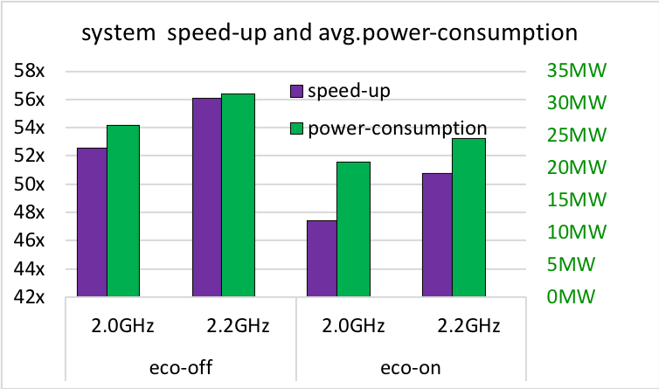
performance and power balance
users can choose the combination of:
CPU frequency mode (2GHz/2.2GHz) and economy mode (on/off)
tapp avg. tendency (est.)
NTChem power profile example, same job, same # of nodes/job
speed and power axes are both relative to eco off normal mode value
speed
power
(W)
color represents mode
Red: eco off boost
Pink: eco off normal
Blue: eco on boost
Green: eco on normal
speed x time = const.(job)
the shorter time, the better
power x time = energy (Wh)
the smaller area, the better
time
time
Notes:
user can choose core frequency and eco mode.
This slide shows the speed and power comparison of NTChem application running the same model.
[Skip]
each app has its own speed-power tendency
administrators can deploy a policy to promote the intended operation
facility power cap, productivity (performance), charging policy

Slide 13
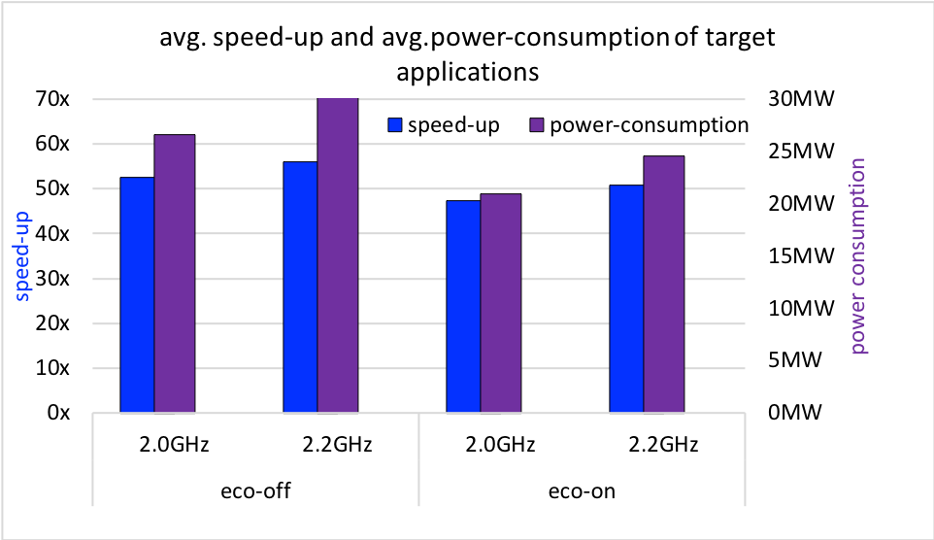
performance and power balance
relative speed-up v.s. K computer and power consumption
The results obtained on the evaluation environment in the trial phase do not guarantee the performance, power and other attributes of the supercomputer Fugaku at the start of its operation.
Notes:
A graph showing the estimated average speed-up of all target applications on Fugaku over K computer in the left axis and power in the right axis.

Slide 14
Codesign achievement
numerous optimization cycles resulting in:
target applications production ready from day 1 on Fugaku
optimized performance on Fugaku, also efficient on modern HPC systems
in depth programming guide for succeeding applications
Fugaku system oriented to HPC applications demand
60+ codesign requests were reflected in the system development phase
early stage codesign contributed to the systems architecture:
processor and memory specification, data mechanism
later stage codesign contributed to the system software:
compiler optimization feature, numerical library, MPI/network library
Notes:
The achievement summary.
the codesign effort is quite fruitful.
Target applications are ready with expected performance.
Fugaku is shaped up for HPC applications demand, with over 60 codesign subjects reflected.
Your can capture some idea from this partial list of codesign.
Wel, this concludes my talk.

Slide 15
Thank you for your watching!
Notes:
Thank you.

Slide 16
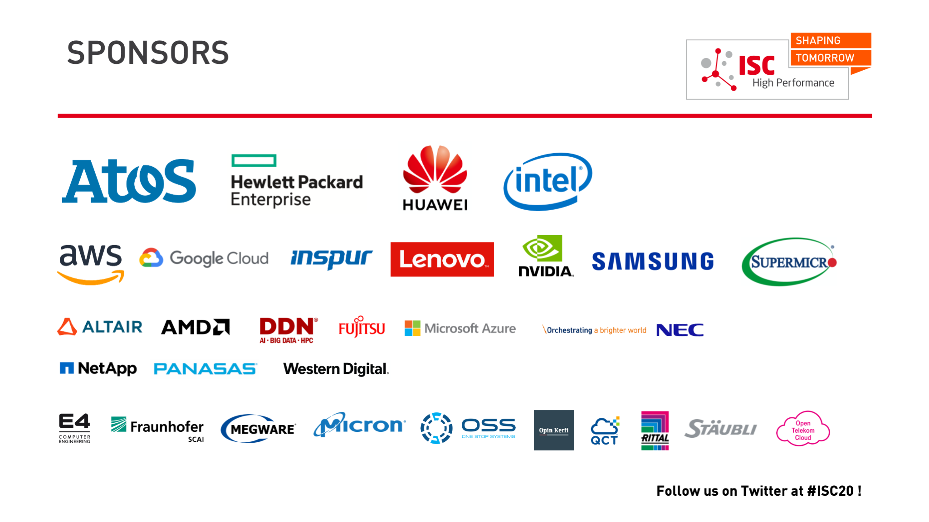

Slide 17


